Slide 1

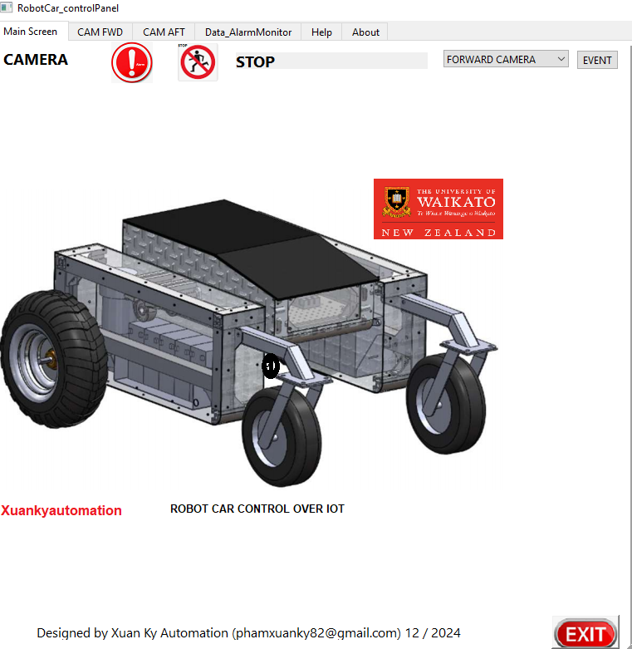
ROBOT CAR CONTROL Revolutionizing Automation with Smart Robotics
COMBINATION OF IOT WITH AI TECHNOLOGY
http://waikatorobotcar.great-site.net
http://robotcarwaikato.great-site.net
https://robotcarwaikato.great-site.net
By: Xuan Ky Pham
ID: 1649932
University Supervisors
Doctor: Melanie Ooi
Date 30/1/2025

Slide 2
Introduction
What is IoT in Robotics?
The Internet of Things (IoT) enables devices to connect, communicate, and make decisions based on data.
In robotics, IoT allows for real-time data exchange, remote control, and automation.
Why Robot Cars with IoT?
Used in autonomous delivery systems, self-driving cars, and smart logistics.
The objective of the Presentation
Explain how IoT enhances robotic vehicles.
Discuss architecture, operation procedure, tools for development, challenges, and future improvements.

Slide 3
Overview of the Robot Car
Brief Description:
A self-driving robot car that uses IoT for remote monitoring, navigation, and control.
Main Features:
Obstacle detection ( By Ultrasonic sensor, RPLidar, By Intel Realsens Camera with YoloV10) Done
Remote control via PS2 Remote, smartphone, or web Done
GPS Auto navigation ( this interface is already made by web page however, the control algorithm is not able to make due to difficulty of position control accuracy) such as Robot Mechanism and Forward wheels, or PID position Control)
PID motor control for speed regulation ( This is not implemented due to very hard to find proper PID Parameter during testing, So this is can be improved in the future)
Using Image of traffic signal to control robot ( this feature is already try by Python with Yolo V11, It worked however the dataset quality can affect to the robot operation and safety issue, this is for future improvement)
Real-World Applications:
Smart transportation, Automated delivery robots, Security surveillance robots

Slide 4
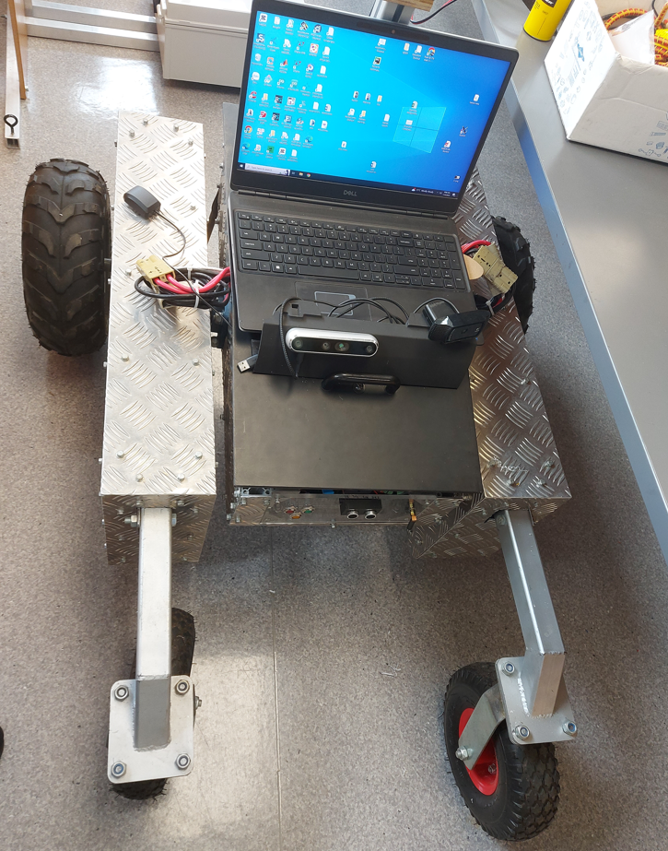
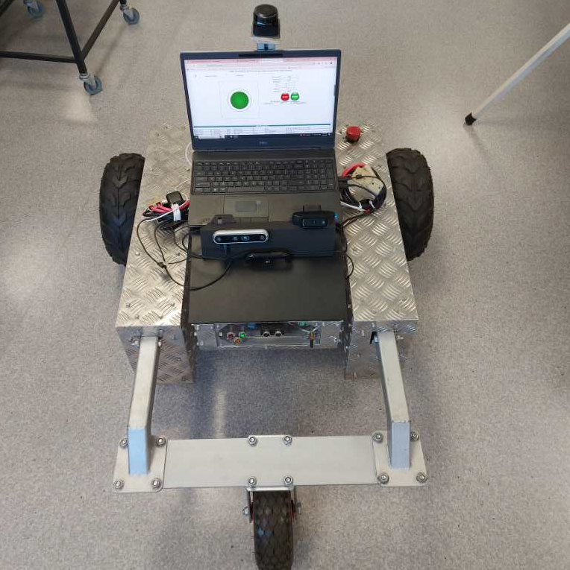

Slide 5
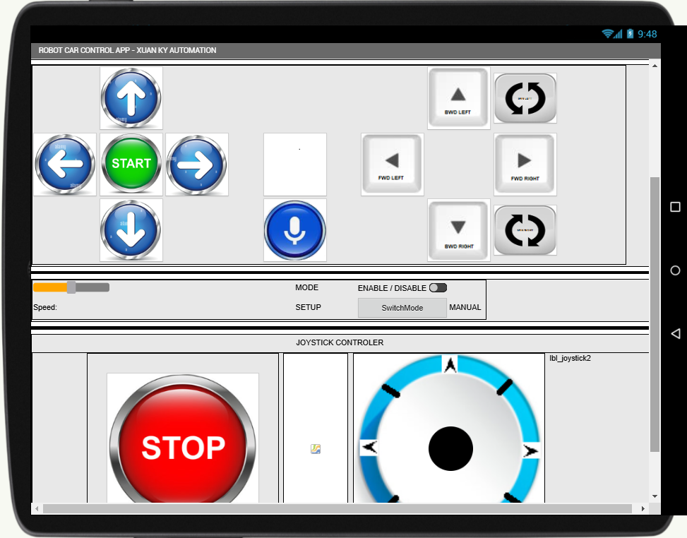
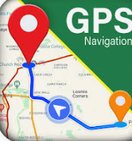
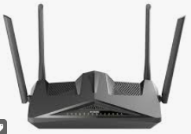
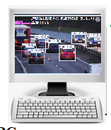
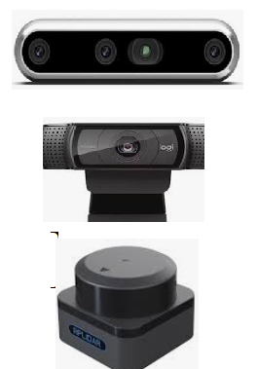
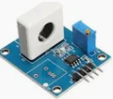
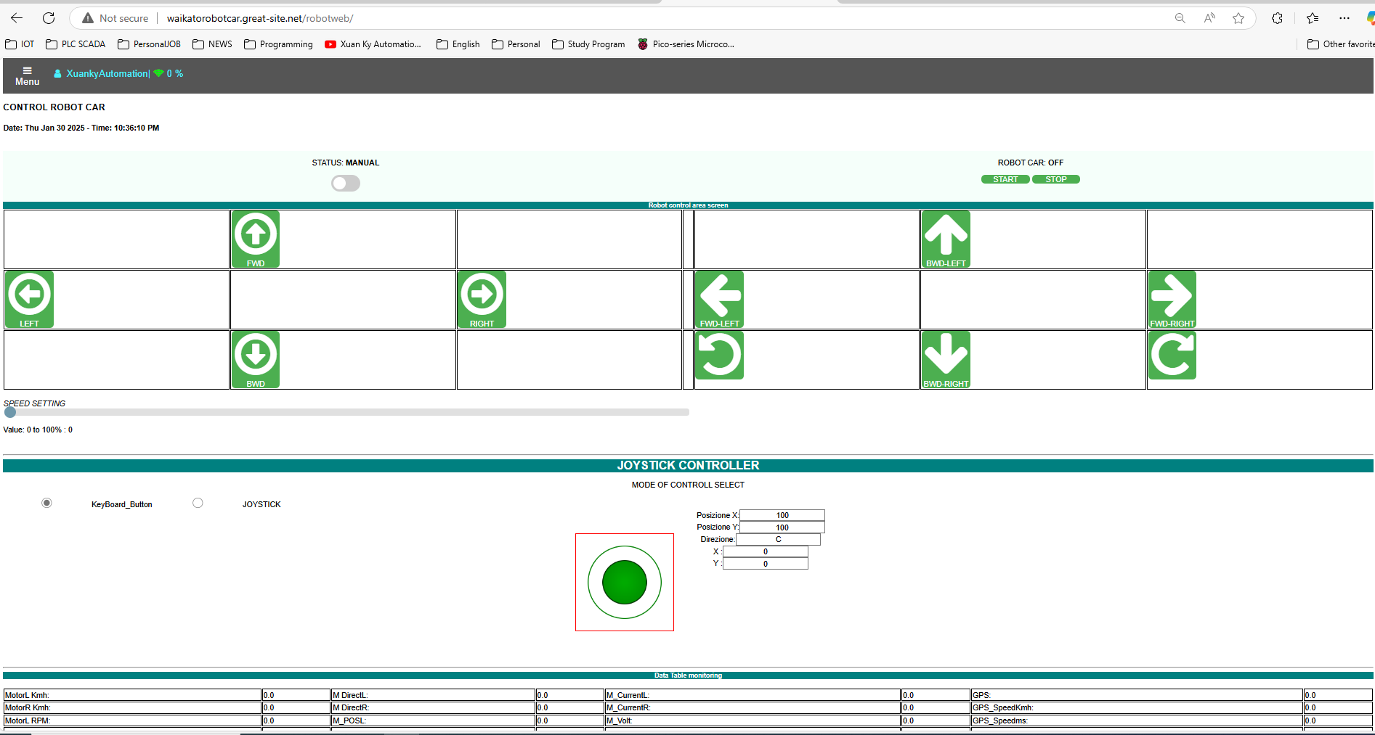
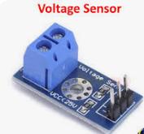
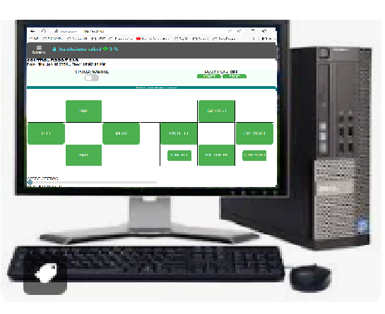
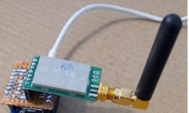
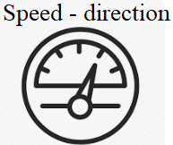
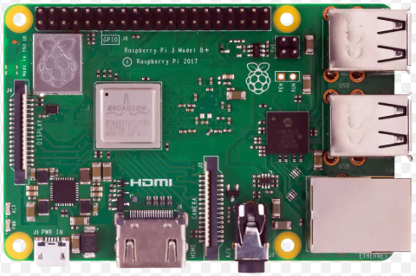
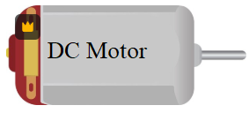
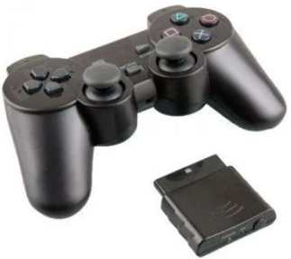
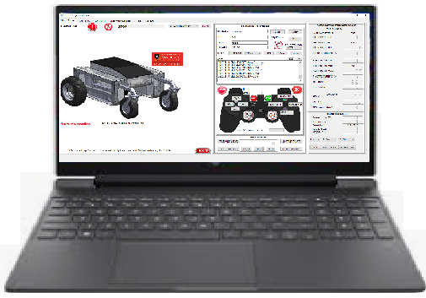
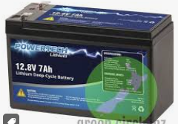
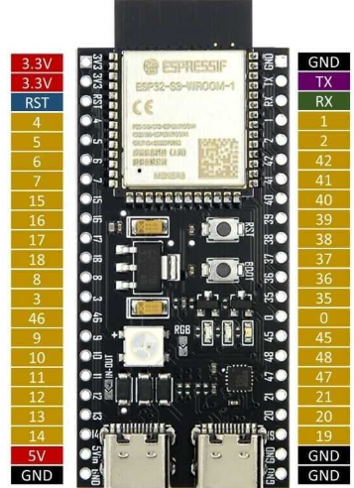
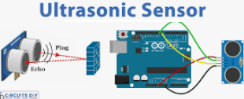
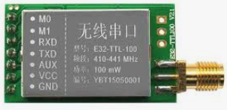
Overview of the Robot Car Hardware
1.Devices
3.Communication
4.HMI
2.Controller

Slide 6
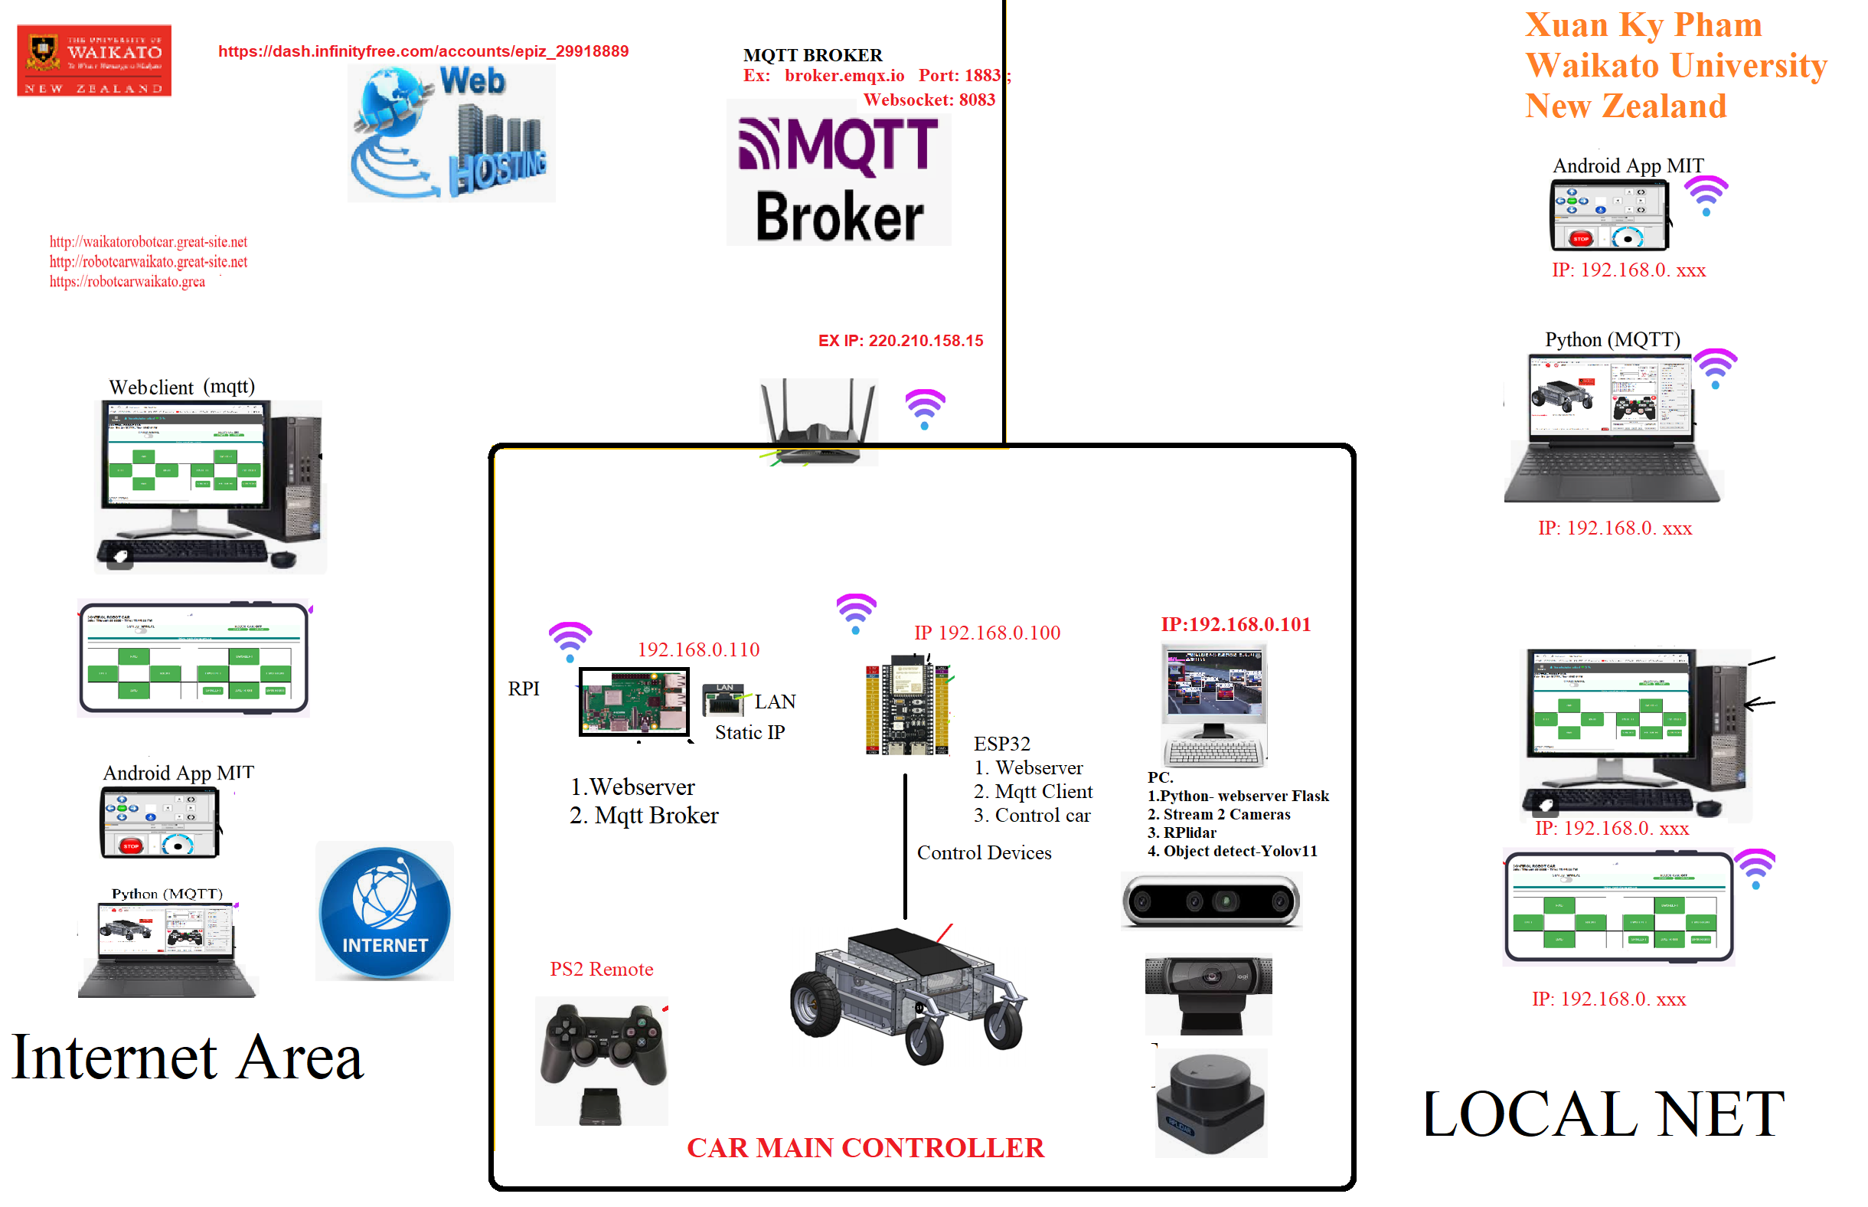

Slide 7
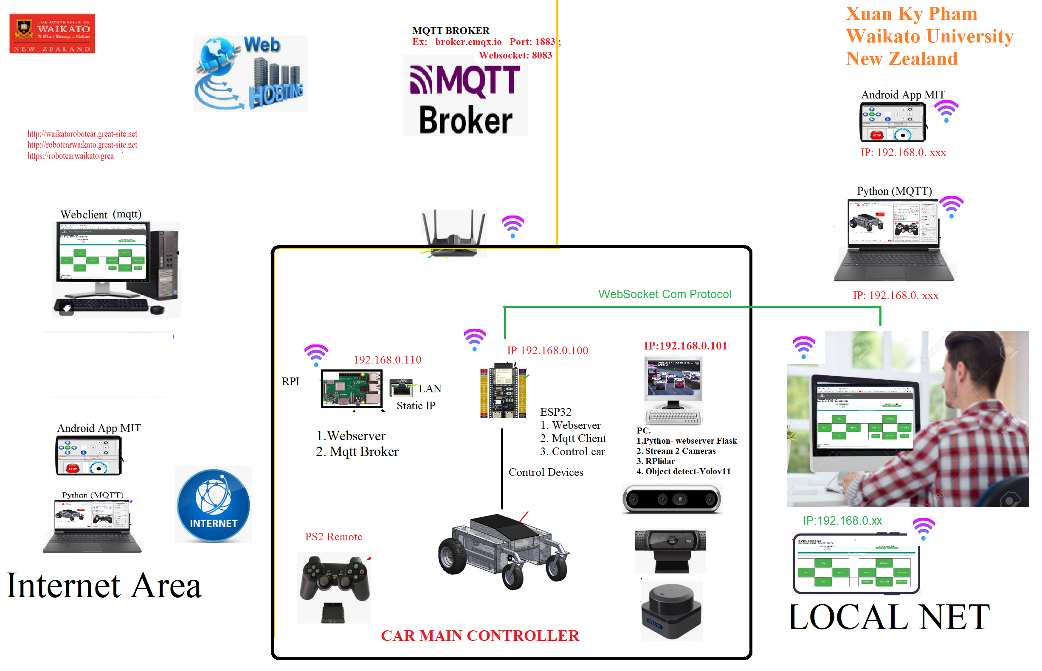

Slide 8
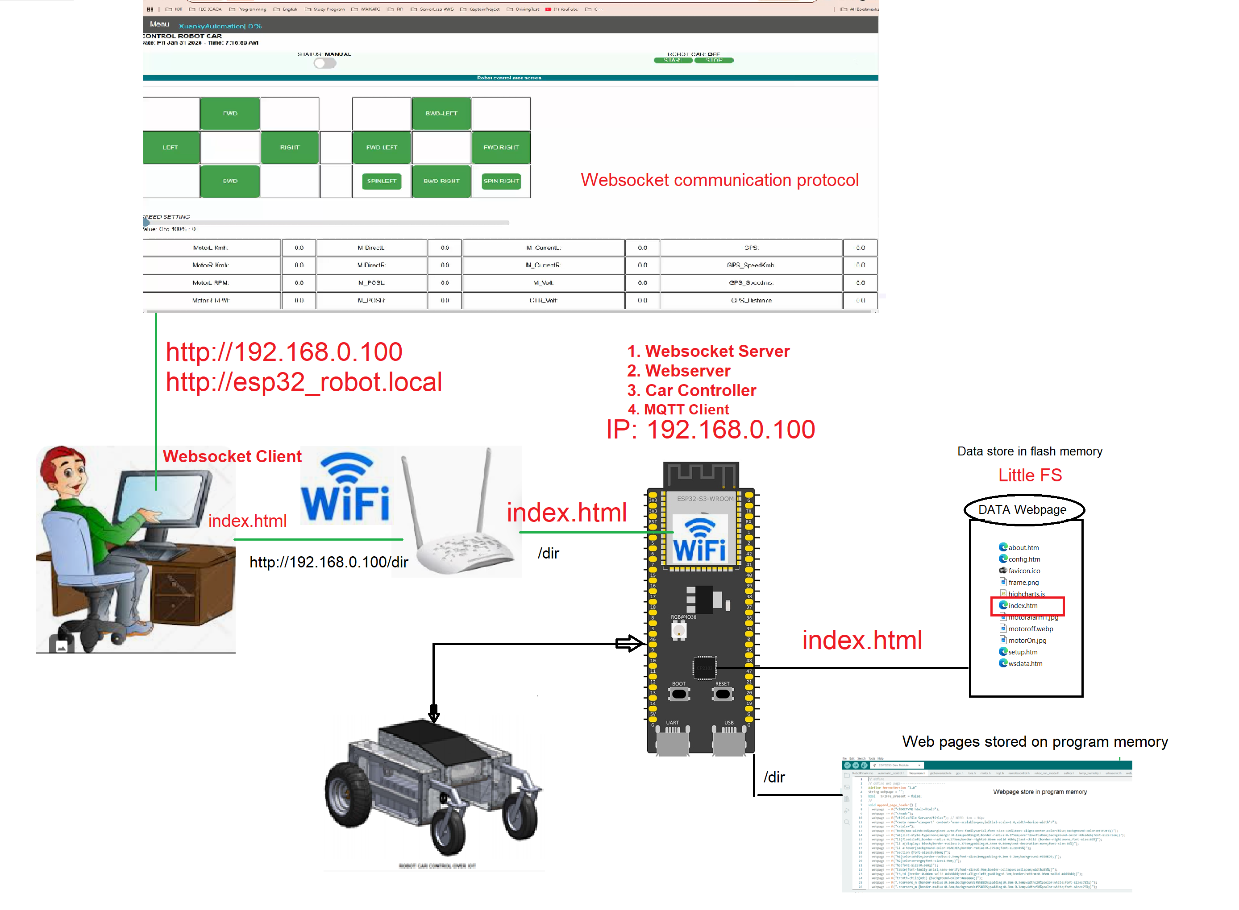

Slide 9
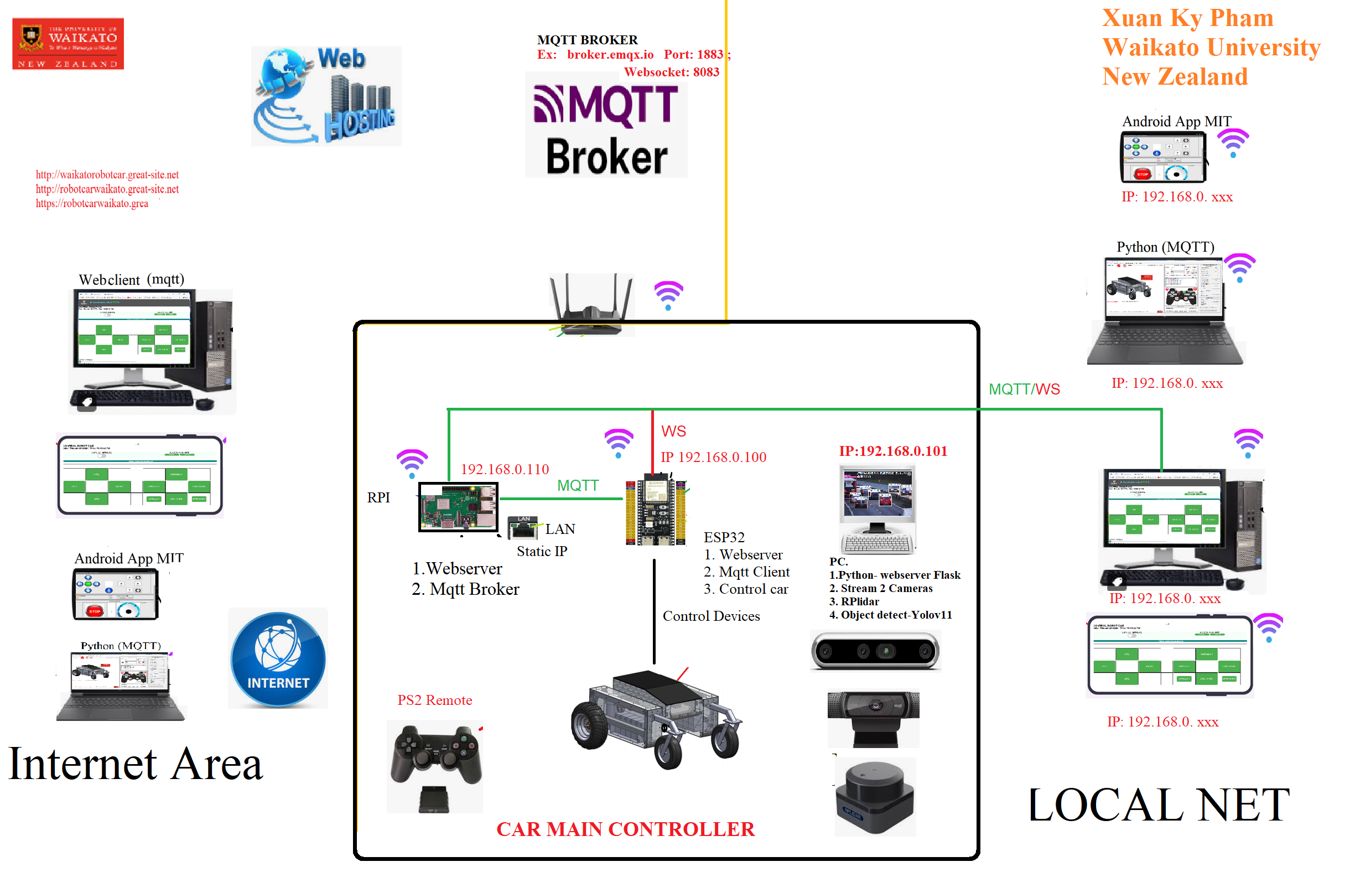

Slide 10
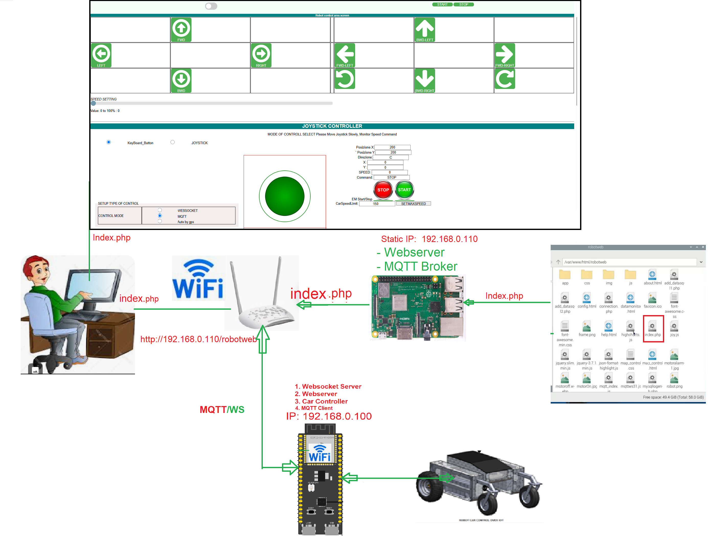

Slide 11
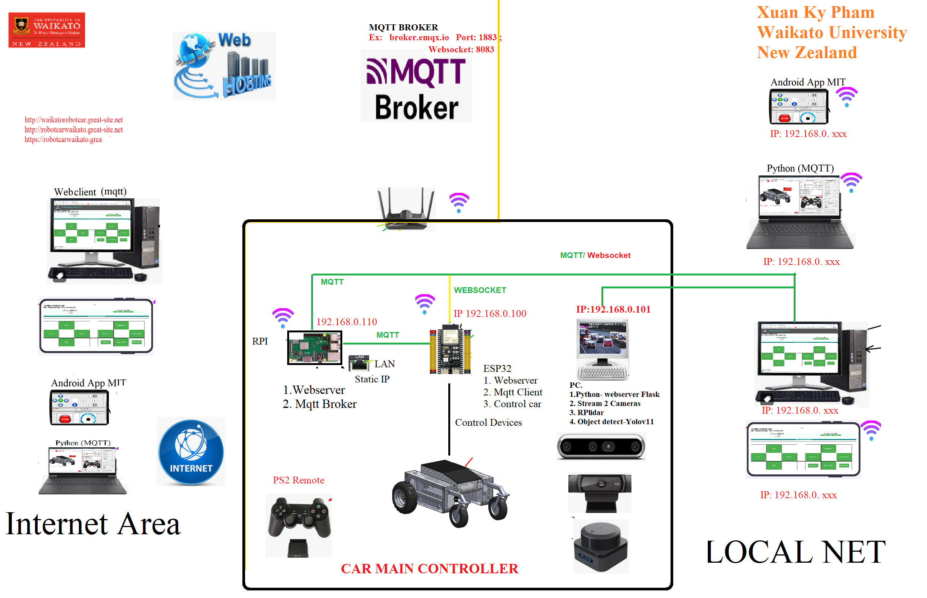

Slide 12
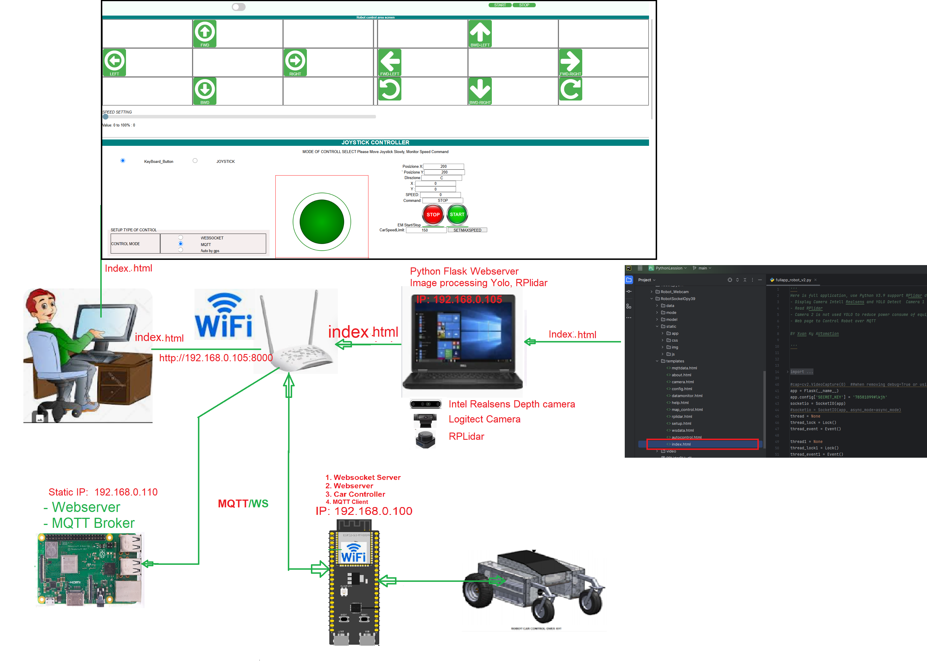

Slide 13
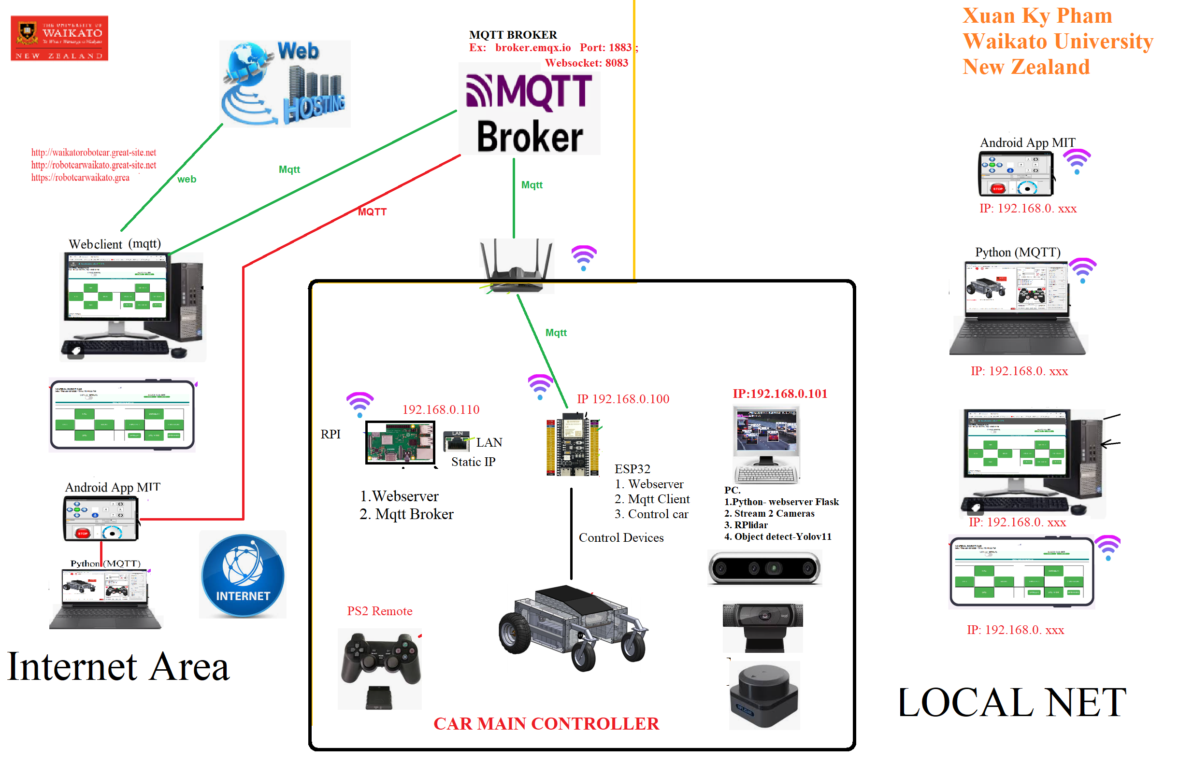

Slide 14
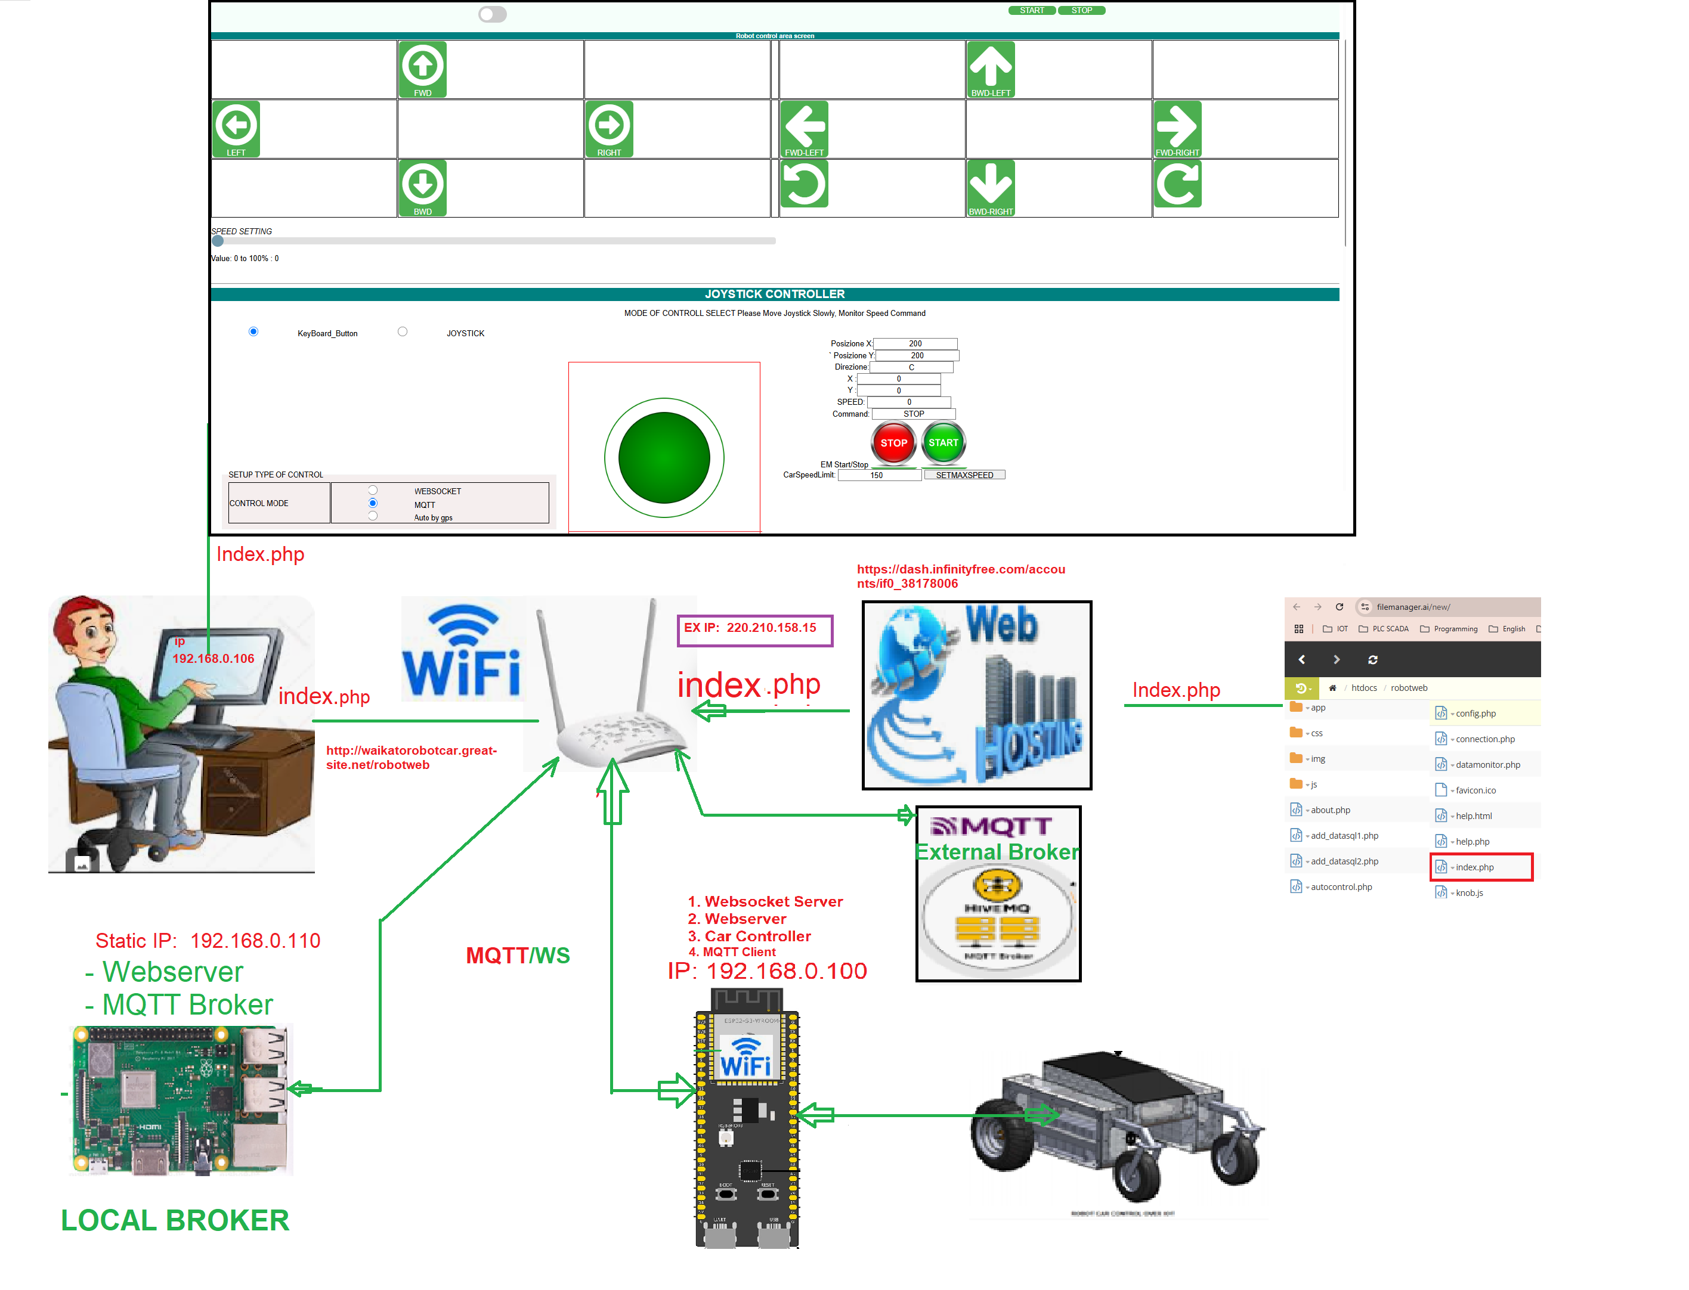

Slide 15
Core Technologies
Connectivity: Wifi MQTT, Websocket, Lora, Remote PS2
YOLOV11 Object Detection and recognition, Rplidar, Stereo Intel RealSen Camera
IOT combination with Image Processing

Slide 16
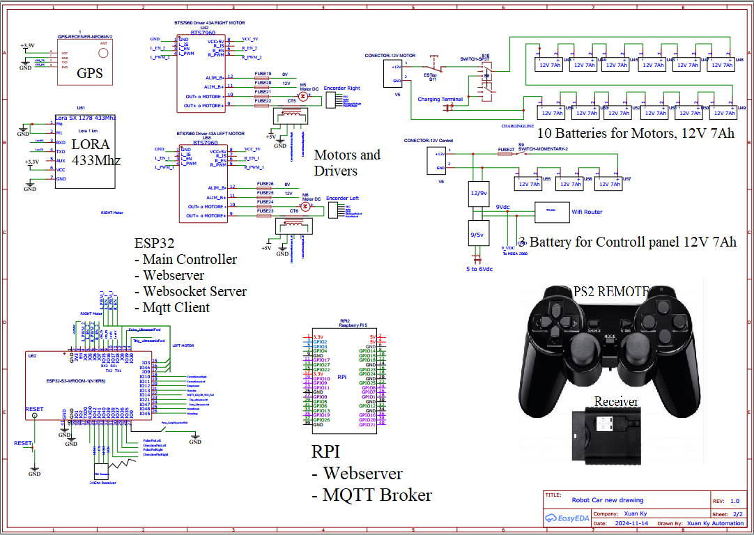
System Architecture & Block Diagram

Slide 17
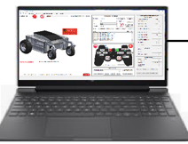
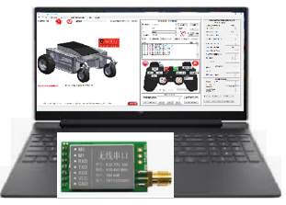
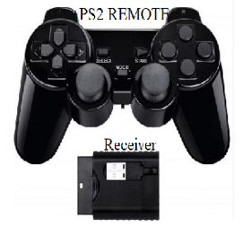
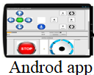
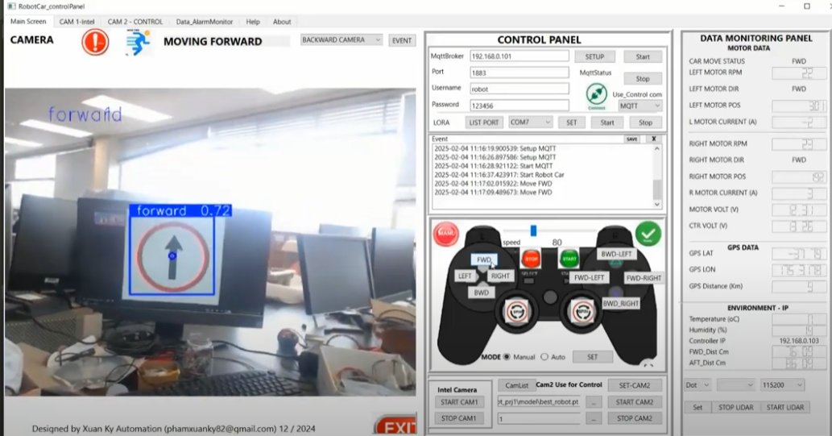
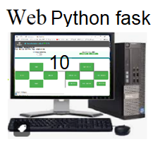
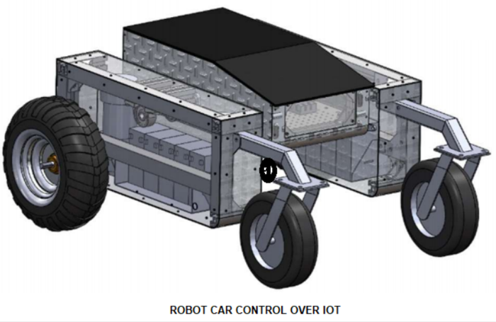
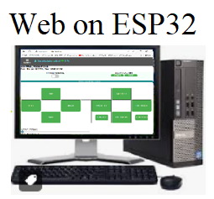
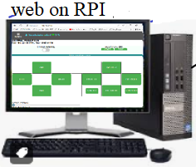
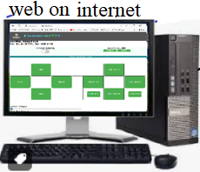
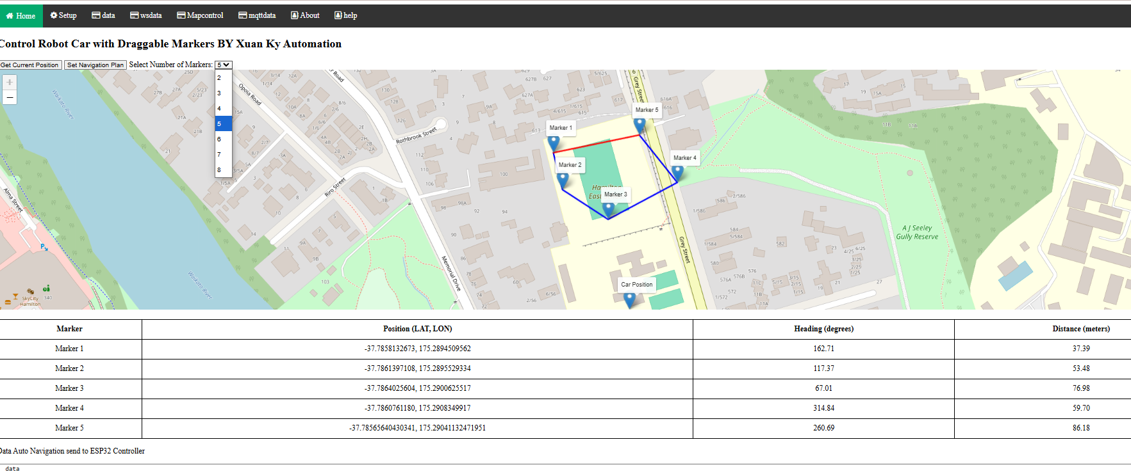
TYPE OF Communications ( MQTT,WS, PS2Remote, Lora)
1.
4. Lora comm
2.
3.MQTT Python app
5.Image Process
6. Automatic by path planning not finish
9
8
7

Slide 18
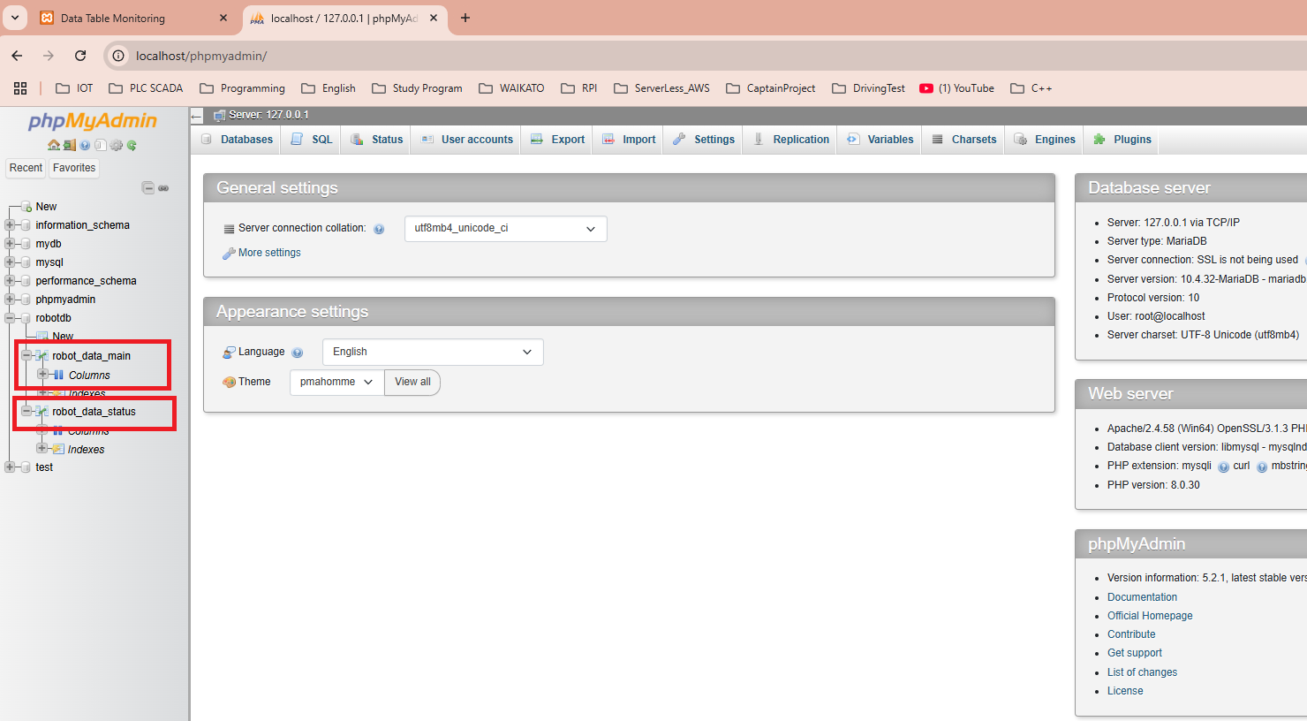
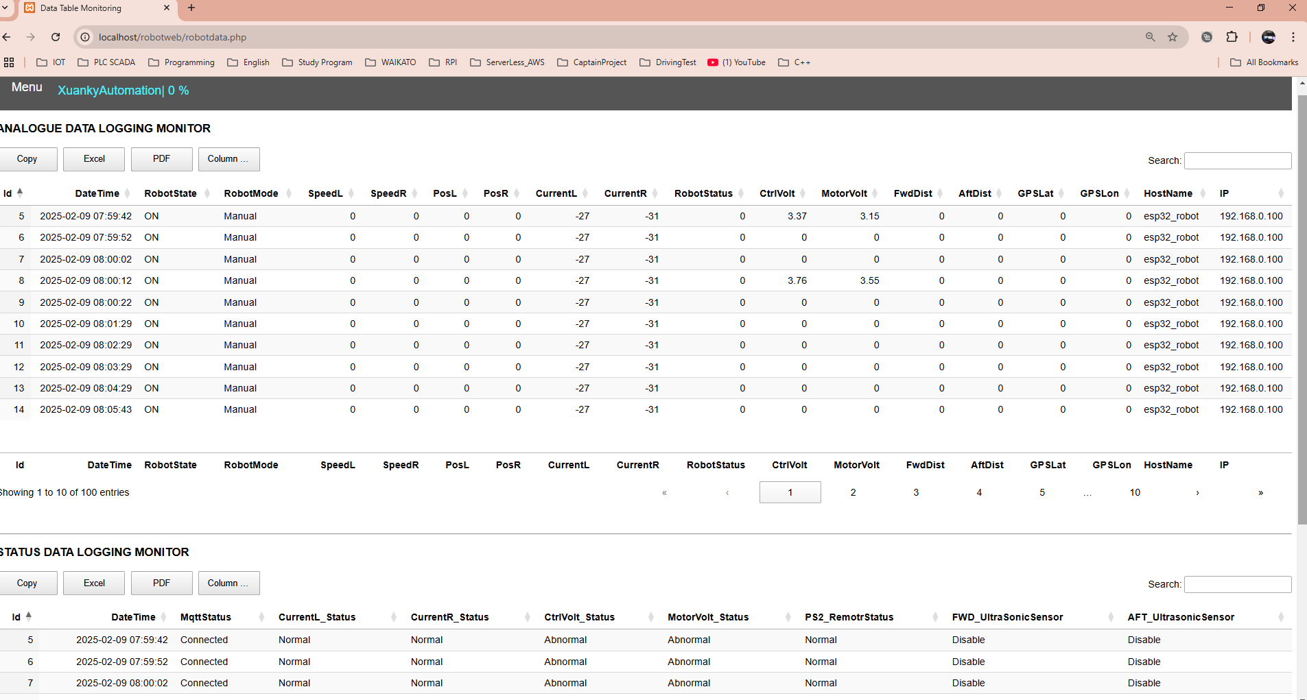
DATA LOGGING BY MY SQL ON RPI OR PC USE PHP

Slide 19
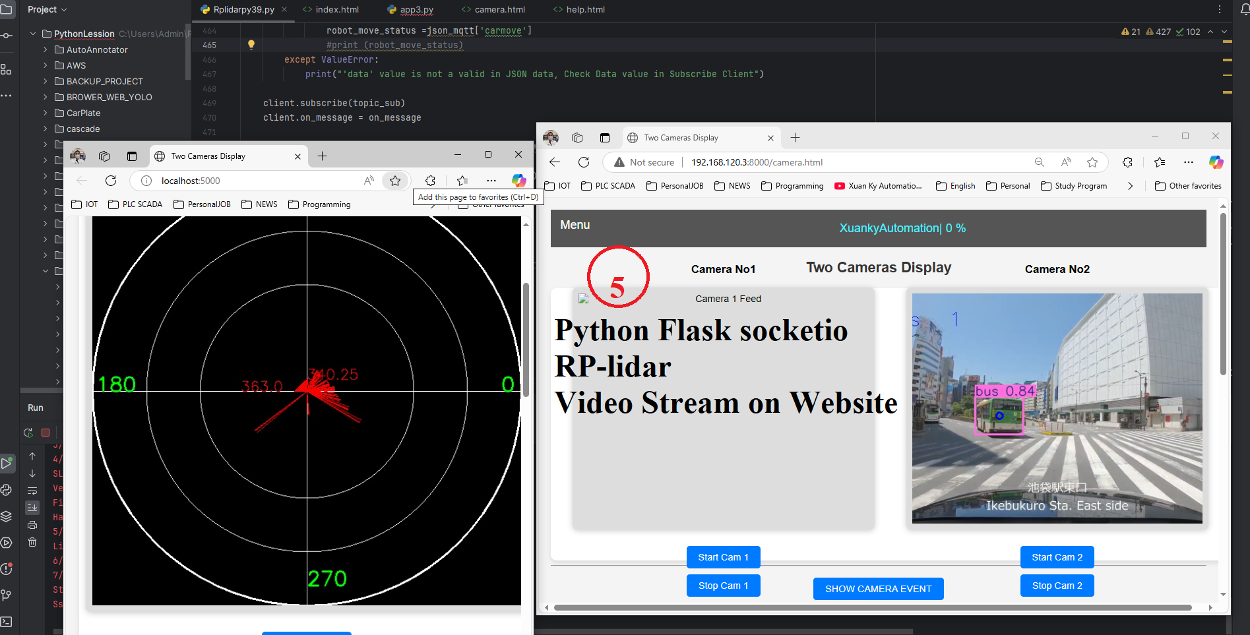
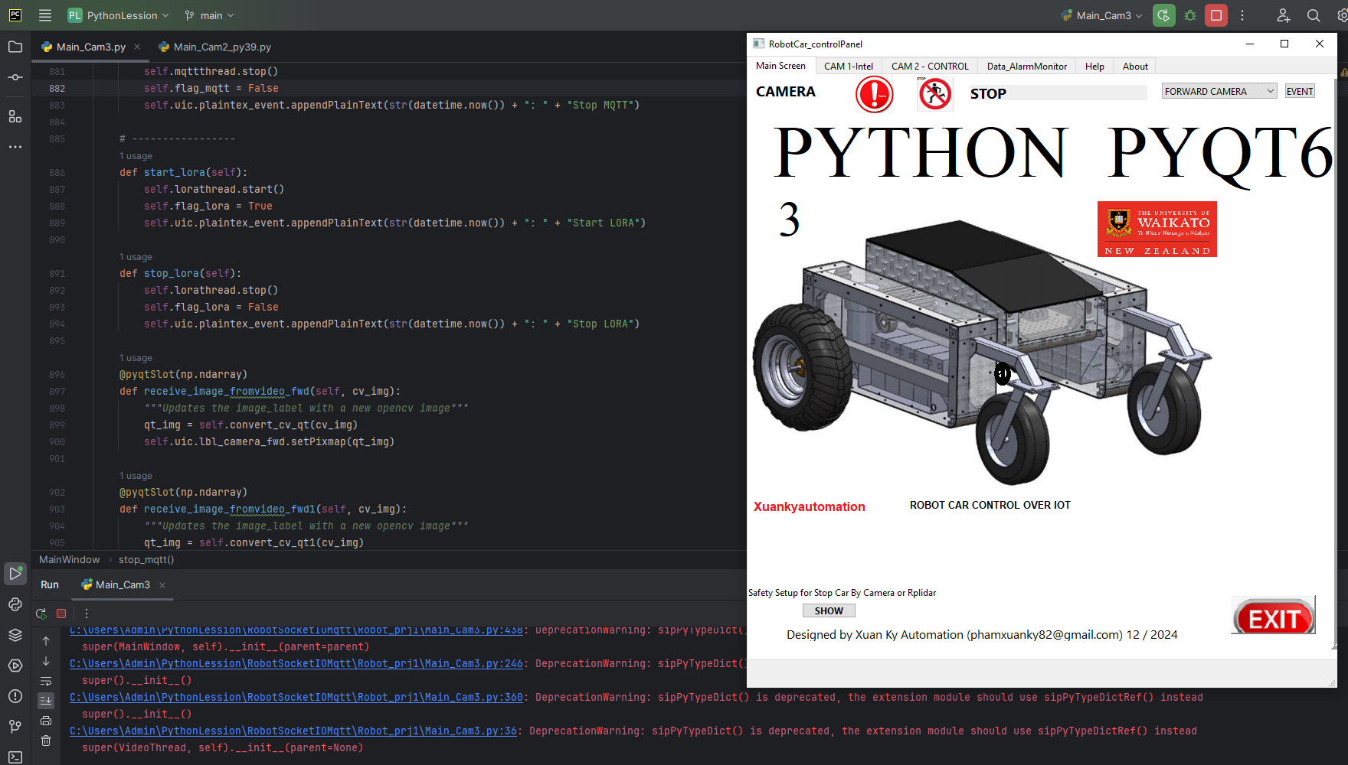
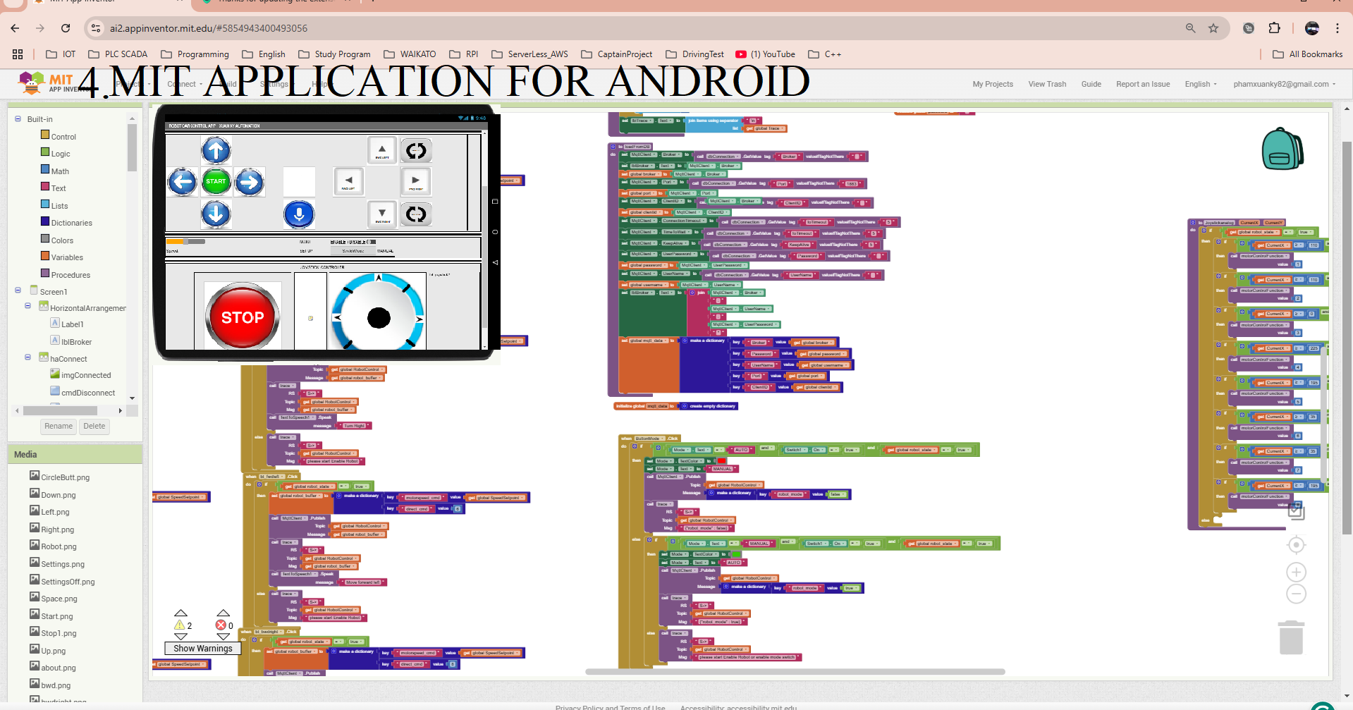
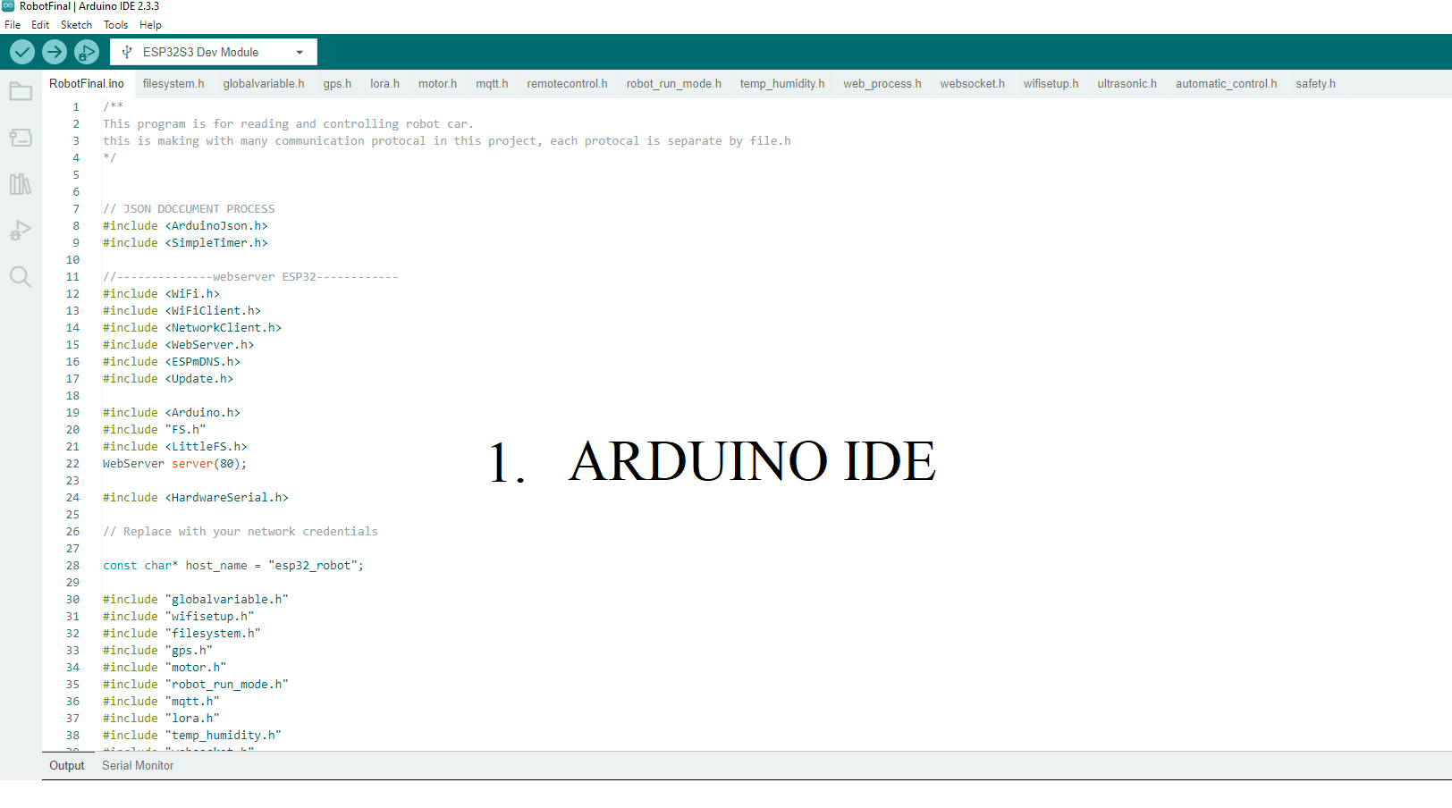
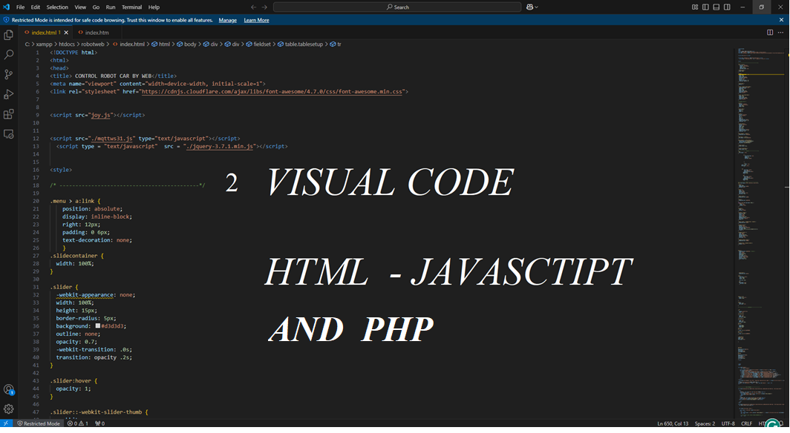
Software Implementation

Slide 20
Safety protection
The robot car is installed with a Current Sensor monitoring to stop the motor whenever the current exceeds the motor's rating after 30 seconds. Motor Fuses are also installed to prevent overcurrent.
A voltage sensor is also installed to stop motors when vol drops down, then the limit setting is about 70% voltage rating to prevent battery over-discharge.
Aft and FWD of Car installed with Ultrasonic Distance sensor to stop the car in the setting safety distance.
Rplidar detects the range of FWD and AFT distance from car to object. If the distance is lower than the distance setting, the car will stop.
By Image Processing Intel Realsens Camera D455, can set any selected Objects in front of the car lower than setting safety distance car will stop.

Slide 21




Safety Devices

Slide 22
Challenges & Limitations
Connectivity Issues: Weak Wi-Fi or mobile networks can affect real-time control.
Sensor Accuracy: GPS drift and ultrasonic sensor noise can impact performance.
Battery Life: IoT components consume more power, requiring efficient energy management.
Environmental Factors: Sunlight interference with reflectance sensors, and road surface issues.
The car's weight, including the battery, also affects the power duration.
Increase safety for unexpected access web to control car, we need to improve the security
Automatically operation by path planning needs to find the Algorithm to control car move

Slide 23
Future Improvements & Applications
Enhance the program of Automatic Control following the navigation plan by GPS
Improve Dataset quality in the control over Traffic Sign
PID control for motor speed and position improvement
Increase Security for website and Robot Data MYSQL
Mysql data store on RPI connection still under resolved.
Control Automatically Car moving by RPlidar Data

Slide 24
Conclusion
IoT allows real-time control & monitoring of robot cars.
The combination of sensors, microcontrollers, and cloud connectivity enables autonomous operation.
The combination of IOT and AI Image processing can be a future technology
IoT-based robot cars with AI are shaping the future of automation.

Slide 25
Q&A
ANY QUESTION?

